Slide 1
BME Senior Design

Slide 2
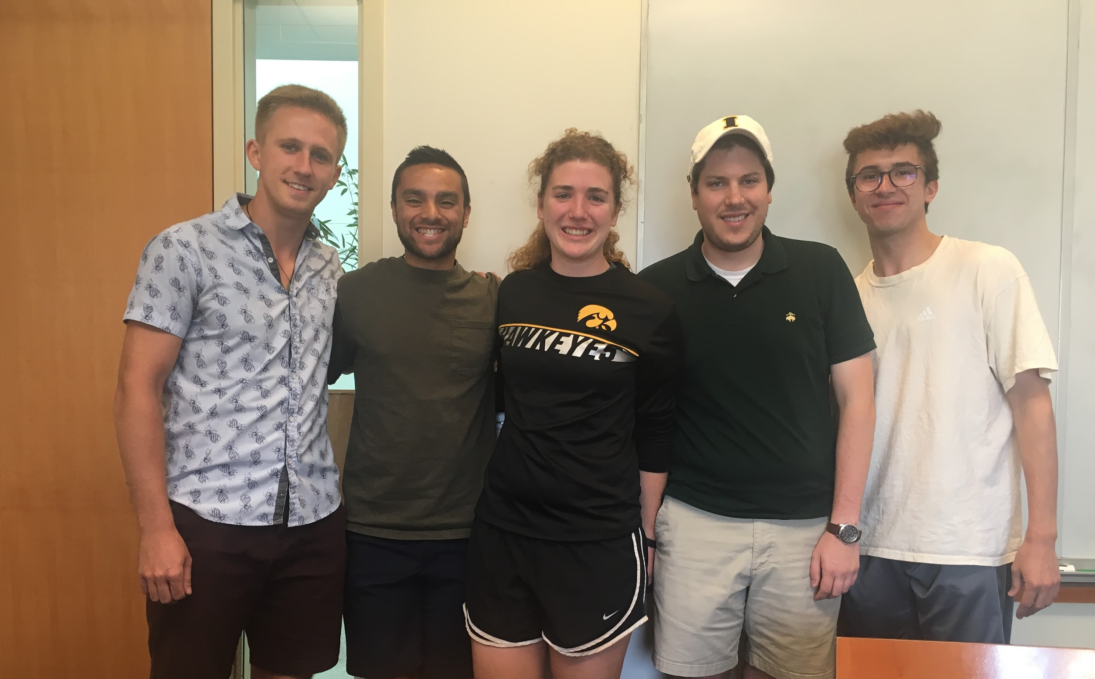
Senior Design Team
Zane Johnson
Matt Situmeang
Erin McFadden
Michael Pass
Tanner Karbonik
(Left to Right)

Slide 3
Question 1/8
What problems does the electronically steerable catheter address?

Slide 4
Question 2/8
Who is this project specifically supposed to help?

Slide 5
Question 3/8
What is the outcome that the project will deliver?

Slide 6
Question 4/8
What are the procedures these catheters will be engaged in?

Slide 7
Question 5/8
What are the major challenges? Why has no one else done it?

Slide 8
Question 6/8
Are there specific design intents that improve functionality that you recommend us going about?

Slide 9
Question 7/8
Are there any outside resources or materials you recommend for us to utilize?
Prototyping in Chicago?
Existing catheter to use?

Slide 10
Question 8/8
Are we limited to mentor’s design specs? Option to think outside the box?

